Slide 1

Product Sales Analysis
ATCHAYA C
Notes:
Hello, I’m Atchaya C, and today I’ll be sharing my findings from the Product Sales Analysis project, which I completed as part of my Data Analyst Certification on DataCamp.

Slide 2
Presentation Content
Overview Of The Project and Business Goals
A Summary of The Work We Undertook
Data Validation
Exploratory Analysis
Key Findings Including the Metric to Monitor and Current Estimation
Recommendations to the Business
Notes:
Let’s start by reviewing the contents of this report. First, I'll give you an overview of the project and outline our business goals. Next, I'll summarize the steps I took to complete this project, including data validation and exploratory analysis. Then, I’ll share my key findings, focusing on the important metrics to monitor and my current estimations. Finally, I’ll provide recommendations for the business.

Slide 3
Business Goals
Maximizing revenue
Choosing the right sales approach
How is revenue related to the sales approaches?
Which sales approach is the best?
Are other factors involved? Such as years_as_customer?
Notes:
So, what are our business goals? Our primary goal is to maximize total revenue. At the end of the day, the most important metric is total revenue—not how many items were sold or how many customers we had. The only thing that defines our success is increasing revenue.
To achieve this, we need to adopt the right sales approach. Our sales team has implemented three different sales strategies, and we need to analyze how each one impacts revenue. By examining the data, we can determine which approach is the most effective in maximizing revenue and generating the highest income.
Additionally, we’ll explore other factors that may influence sales performance. For instance, we’ll answer questions like: Which states should be prioritized for sales? And does the length of a customer’s relationship with us result in higher revenue?

Slide 4
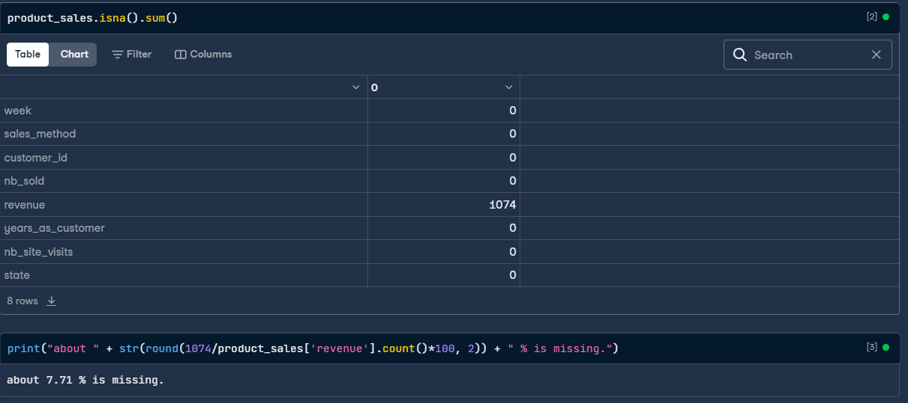
Data Validation 1/10
Notes:
I've summed up all the missing values per column in our dataset, and we can see that there are 1,074 missing values in the revenue column, which makes up about 7.7% of the total rows. That's quite a lot of data, so we can't just drop these rows, as it would introduce bias.

Slide 5
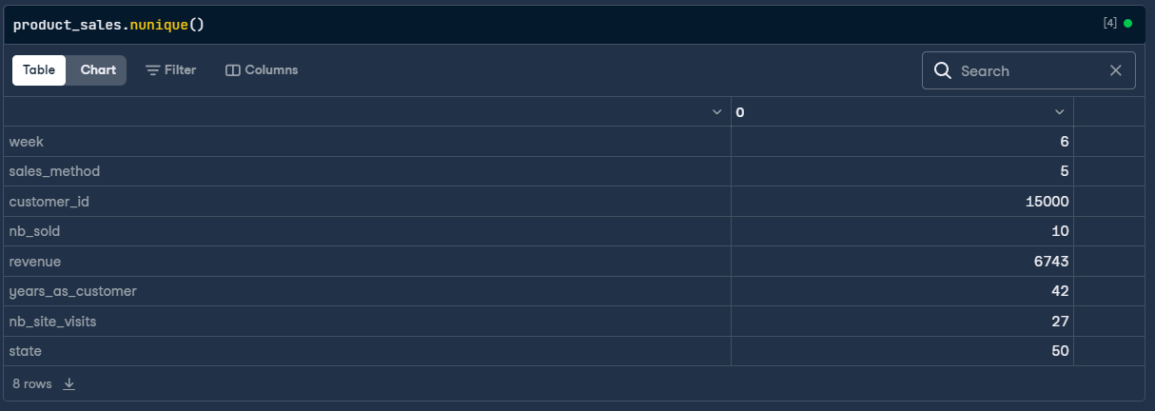
Data Validation 2/10
Notes:
Now, let's take a look at the number of unique values in each column, especially for categorical columns like the sales method. The sales method should only have three categories, but as you can see, there are five unique values. This is likely due to misspelled or incorrect data. We’ll need to make some corrections.

Slide 6
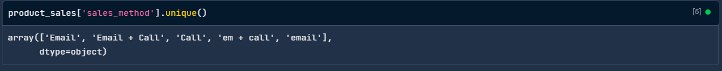
Data Validation 3/10
Notes:
It’s obvious what replacements need to be done.

Slide 7
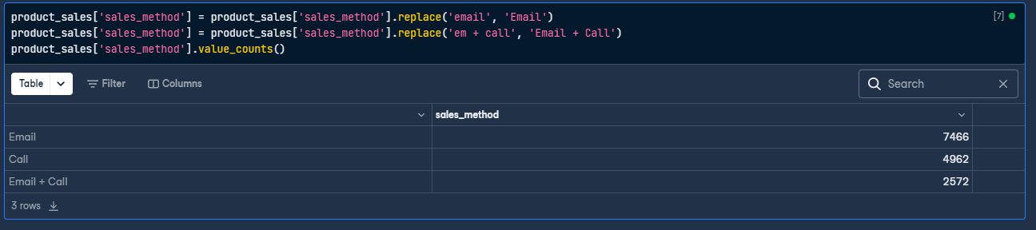
Data Validation 4/10
Notes:
Here’s the result after the corrections, and now you can see that there are no more misspelled entries in the sales method column.

Slide 8

Data Validation 5/10
Notes:
Moving on to the state column, everything looks good there, so no further action is needed.

Slide 9
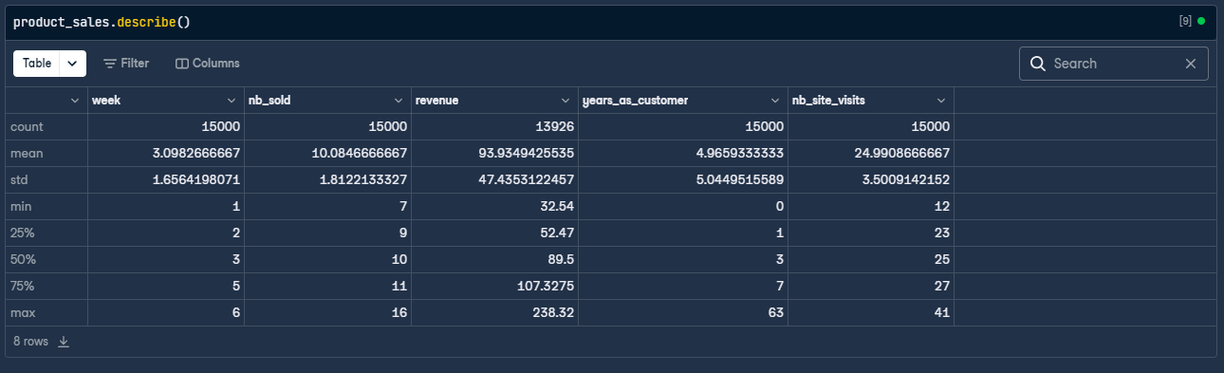
Data Validation 6/10
Notes:
Next, let's quickly review the summary statistics of product sales. You can see that the maximum value in the "years as a customer" column is 63, which isn't possible since the business has only been around for 40 years.

Slide 10
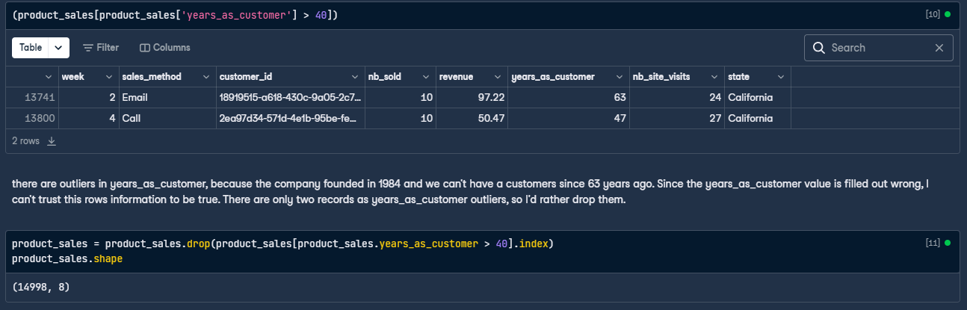
Data Validation 7/10
Notes:
There are two rows where this value exceeds 40 years, so I’ve decided to drop them.

Slide 11
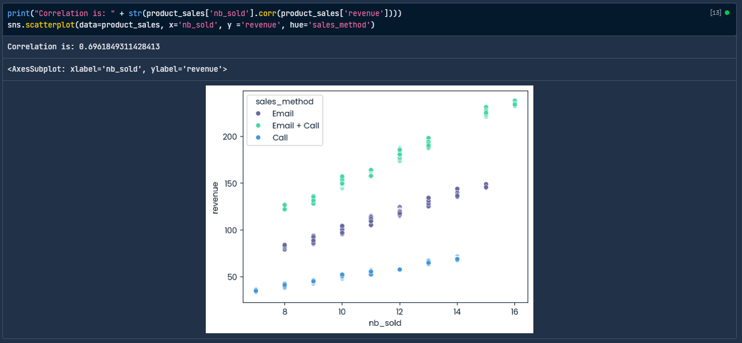
Data Validation 8/10
Notes:
Now that we've cleaned up the sales method column, let's explore how the number of items sold and revenue are related. I’ve also calculated the correlation between these two columns, and it’s about 0.7, indicating a strong relationship.
You can also clearly see a pattern between revenue and each sales method. Since there is a relationship between the 'revenue' and the 'sales_method' column, It make total sense to take the median revenue for each sales method and use it to replace the missing values in the revenue column.

Slide 12
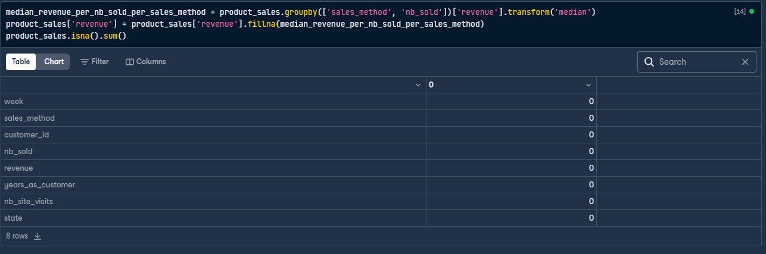
Data Validation 9/10
Notes:
After this step, we have no more missing values in the dataset.

Slide 13
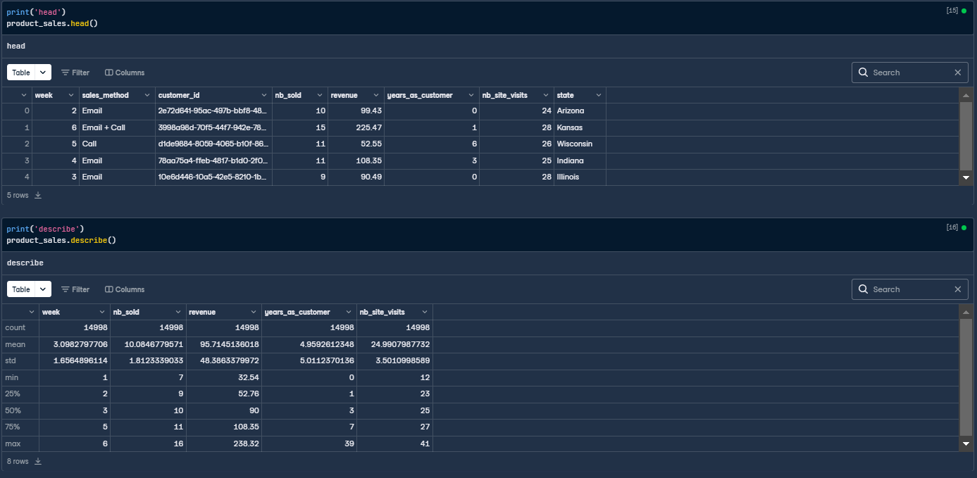
Data Validation 10/10
Notes:
And here is a final look at our data between diving into the exploratory analysis

Slide 14
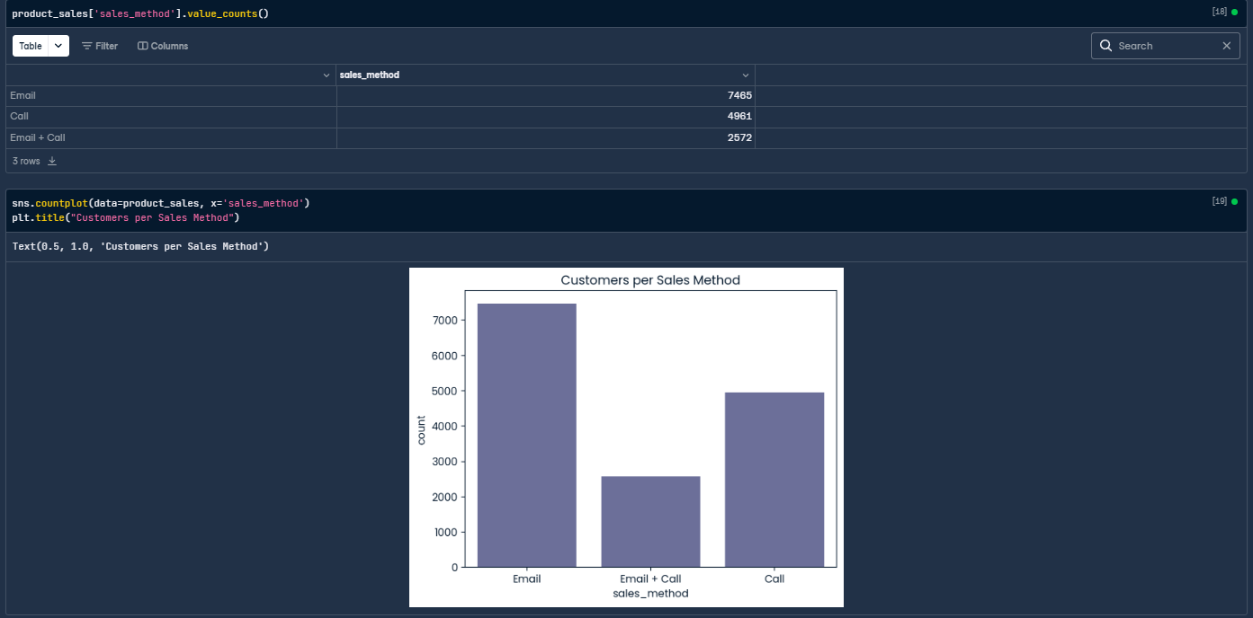
Exploratory Analysis: How Many Customers Were There For Each Approach?
Notes:
Now, let’s look at how many customers used each approach. There were 7,465 for the email method, 4,961 for the call method, and 2,572 for the email plus call method. This suggests that our sales team preferred the email method over the call method, and the call method over the email plus call method. This could be because the email method is the easiest, least time-consuming, and requires less effort compared to the others, while the email plus call method involves the most work.

Slide 15
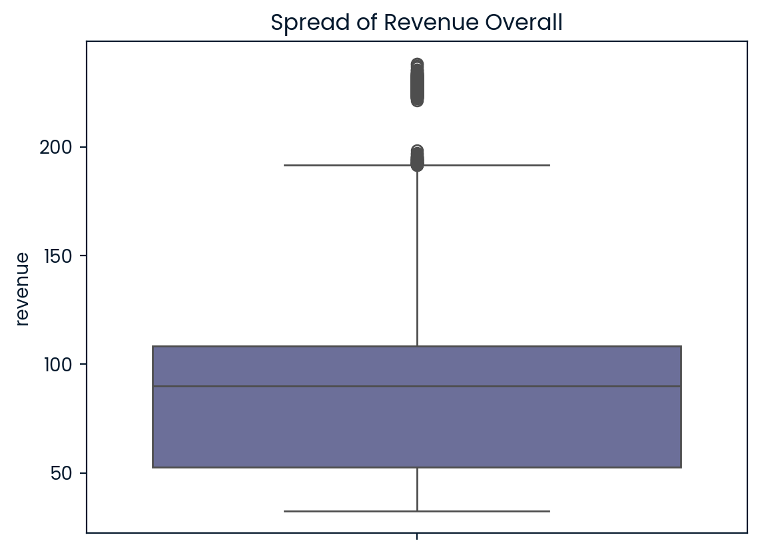
Exploratory Analysis: what does the spread of the revenue look like overall? And for each method?
Notes:
Here’s the spread pf revenue overall.

Slide 16
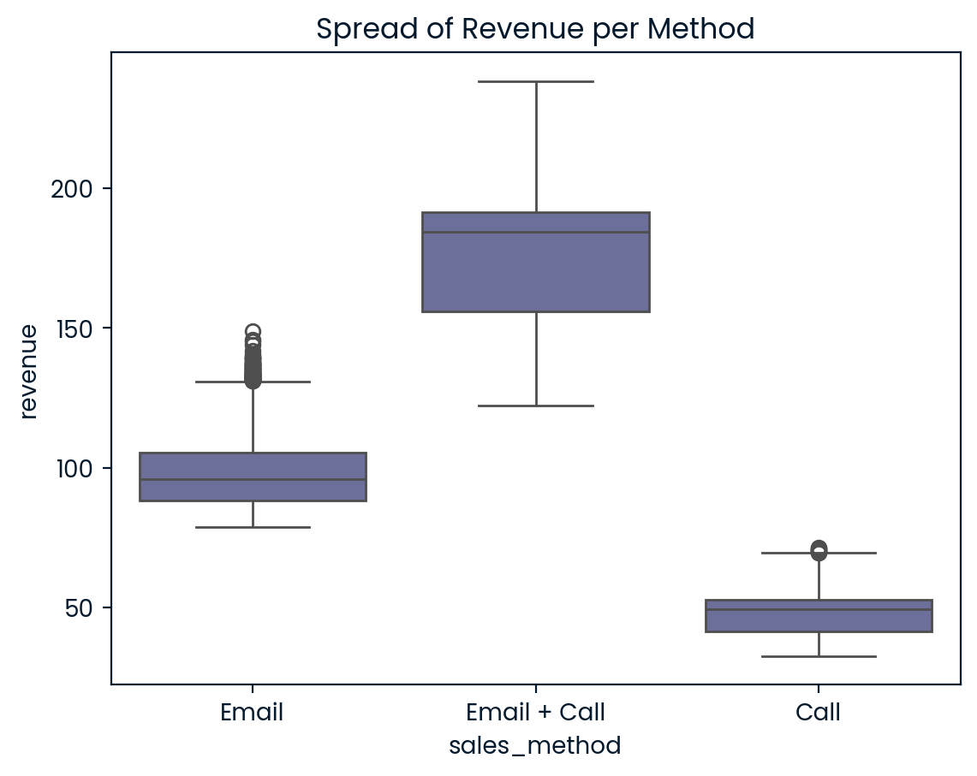
Exploratory Analysis: what does the spread of the revenue look like overall? And for each method?
Notes:
Here’s the spread pf revenue per method.
When we look at the revenue distribution per method, it's clear that the email plus call method takes first place in terms of revenue generation, followed by the email method, and finally, the call method. You can clearly see how the email plus call method results in much higher sales.

Slide 17
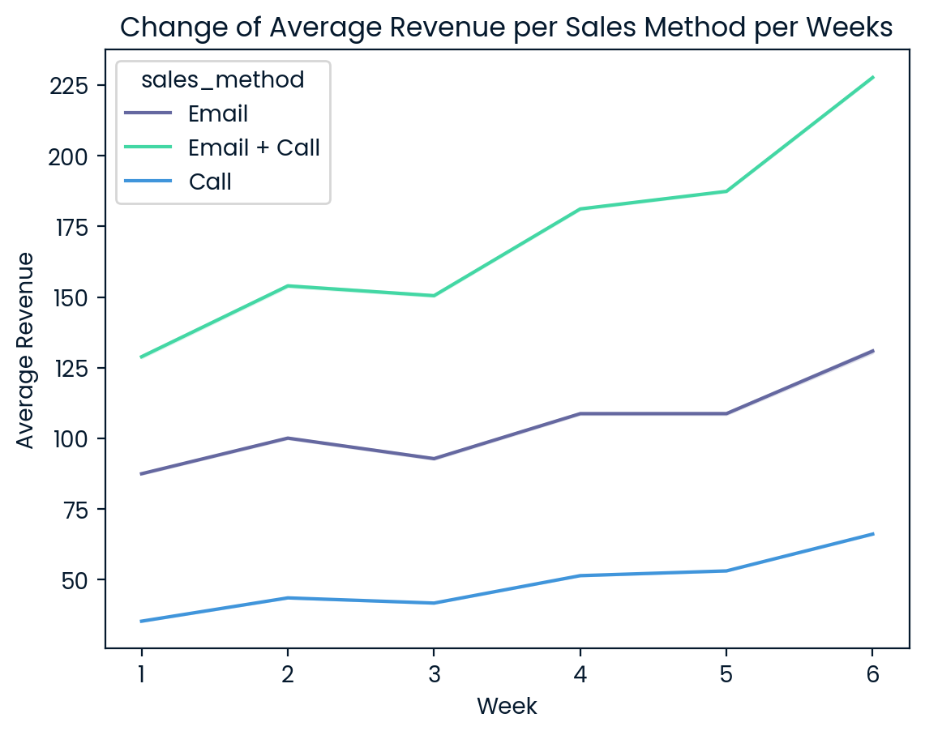
Exploratory Analysis: Was there any difference in revenue over time for each of the methods?
Notes:
So, is there any difference in revenue over time for each sales method? You can clearly see that the average revenue per sale increases over time. However, the email plus call method shows a slight steeper increase compared to the other two methods. Still, this isn’t enough to make a final decision, as we need to remember that total revenue is our key focus.

Slide 18
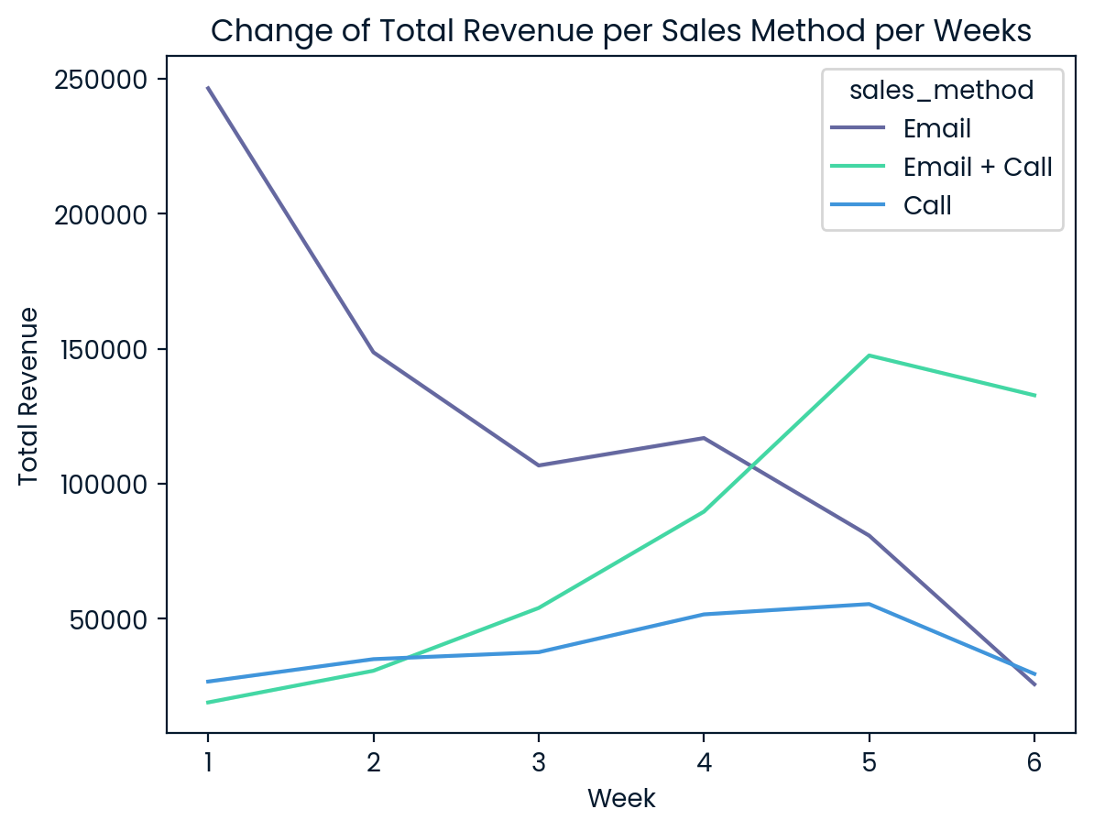
Exploratory Analysis: Was there any difference in revenue over time for each of the methods?
Notes:
Let’s look at how total revenue changes per sales method over the weeks. You’ll notice that the email method started off with significantly higher sales than the other two methods. However, as time passed, revenue from the email approach dropped sharply.
In contrast, the email plus call method showed significant growth over time, while the call method increased gradually. However, after the fifth week, both email plus call and call method revenues started to decline slightly. Despite this, we expect that the email plus call method will continue to generate much higher revenue in the future.

Slide 19
Exploratory Analysis: Which method would you recommend we continue to use?
Call : Takes too long (30 mins). Low Revenue Rate
Email : Takes almost no time. Medium Revenue Rate
Email + Call: Takes almost 10 mins time. Very High Revenue Rate
Notes:
So, which method should we recommend? The call method takes the longest—around 30 minutes per sale—yet it brings in the lowest revenue. The email method, on the other hand, takes almost no time but results in a moderate revenue rate. The email plus call method takes around 10 minutes and produces the highest revenue.
Based on this, I suggest prioritizing the email plus call method if we are willing to invest more time for higher revenue. The email method is also a good option since it requires little time and delivers a medium revenue rate. However, the call method should definitely be set aside, as it takes too long and generates the lowest revenue of all three approaches

Slide 20
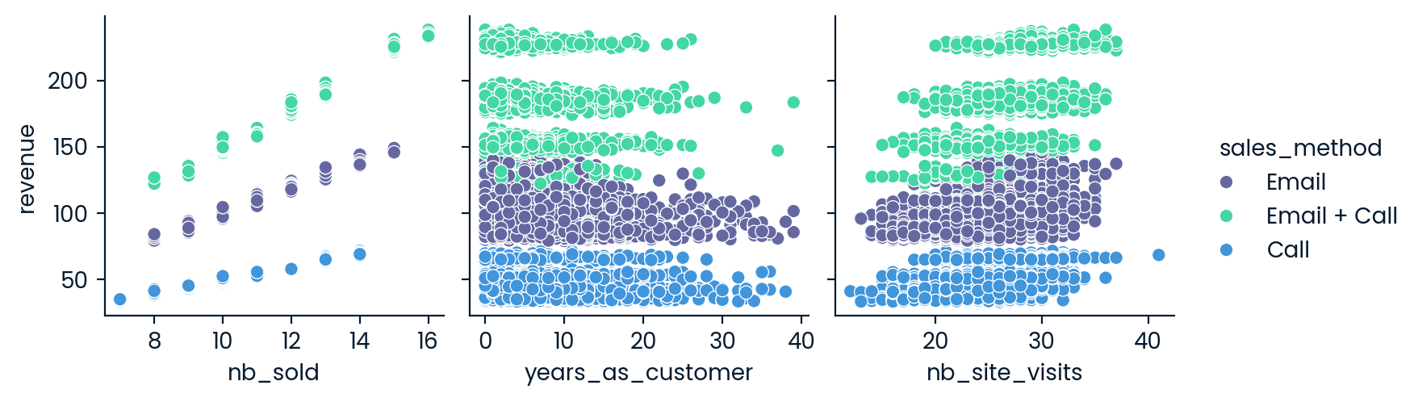
Key Findings Including the Metric to Monitor and Current Estimation
Other factors don’t matter much
Notes:
Now, let’s explore other findings, including key metrics to monitor and our current estimations. We also examined factors such as years as a customer and the number of site visits. The data shows that revenue is not significantly influenced by how long someone has been a customer or how many times they have visited our site.

Slide 21
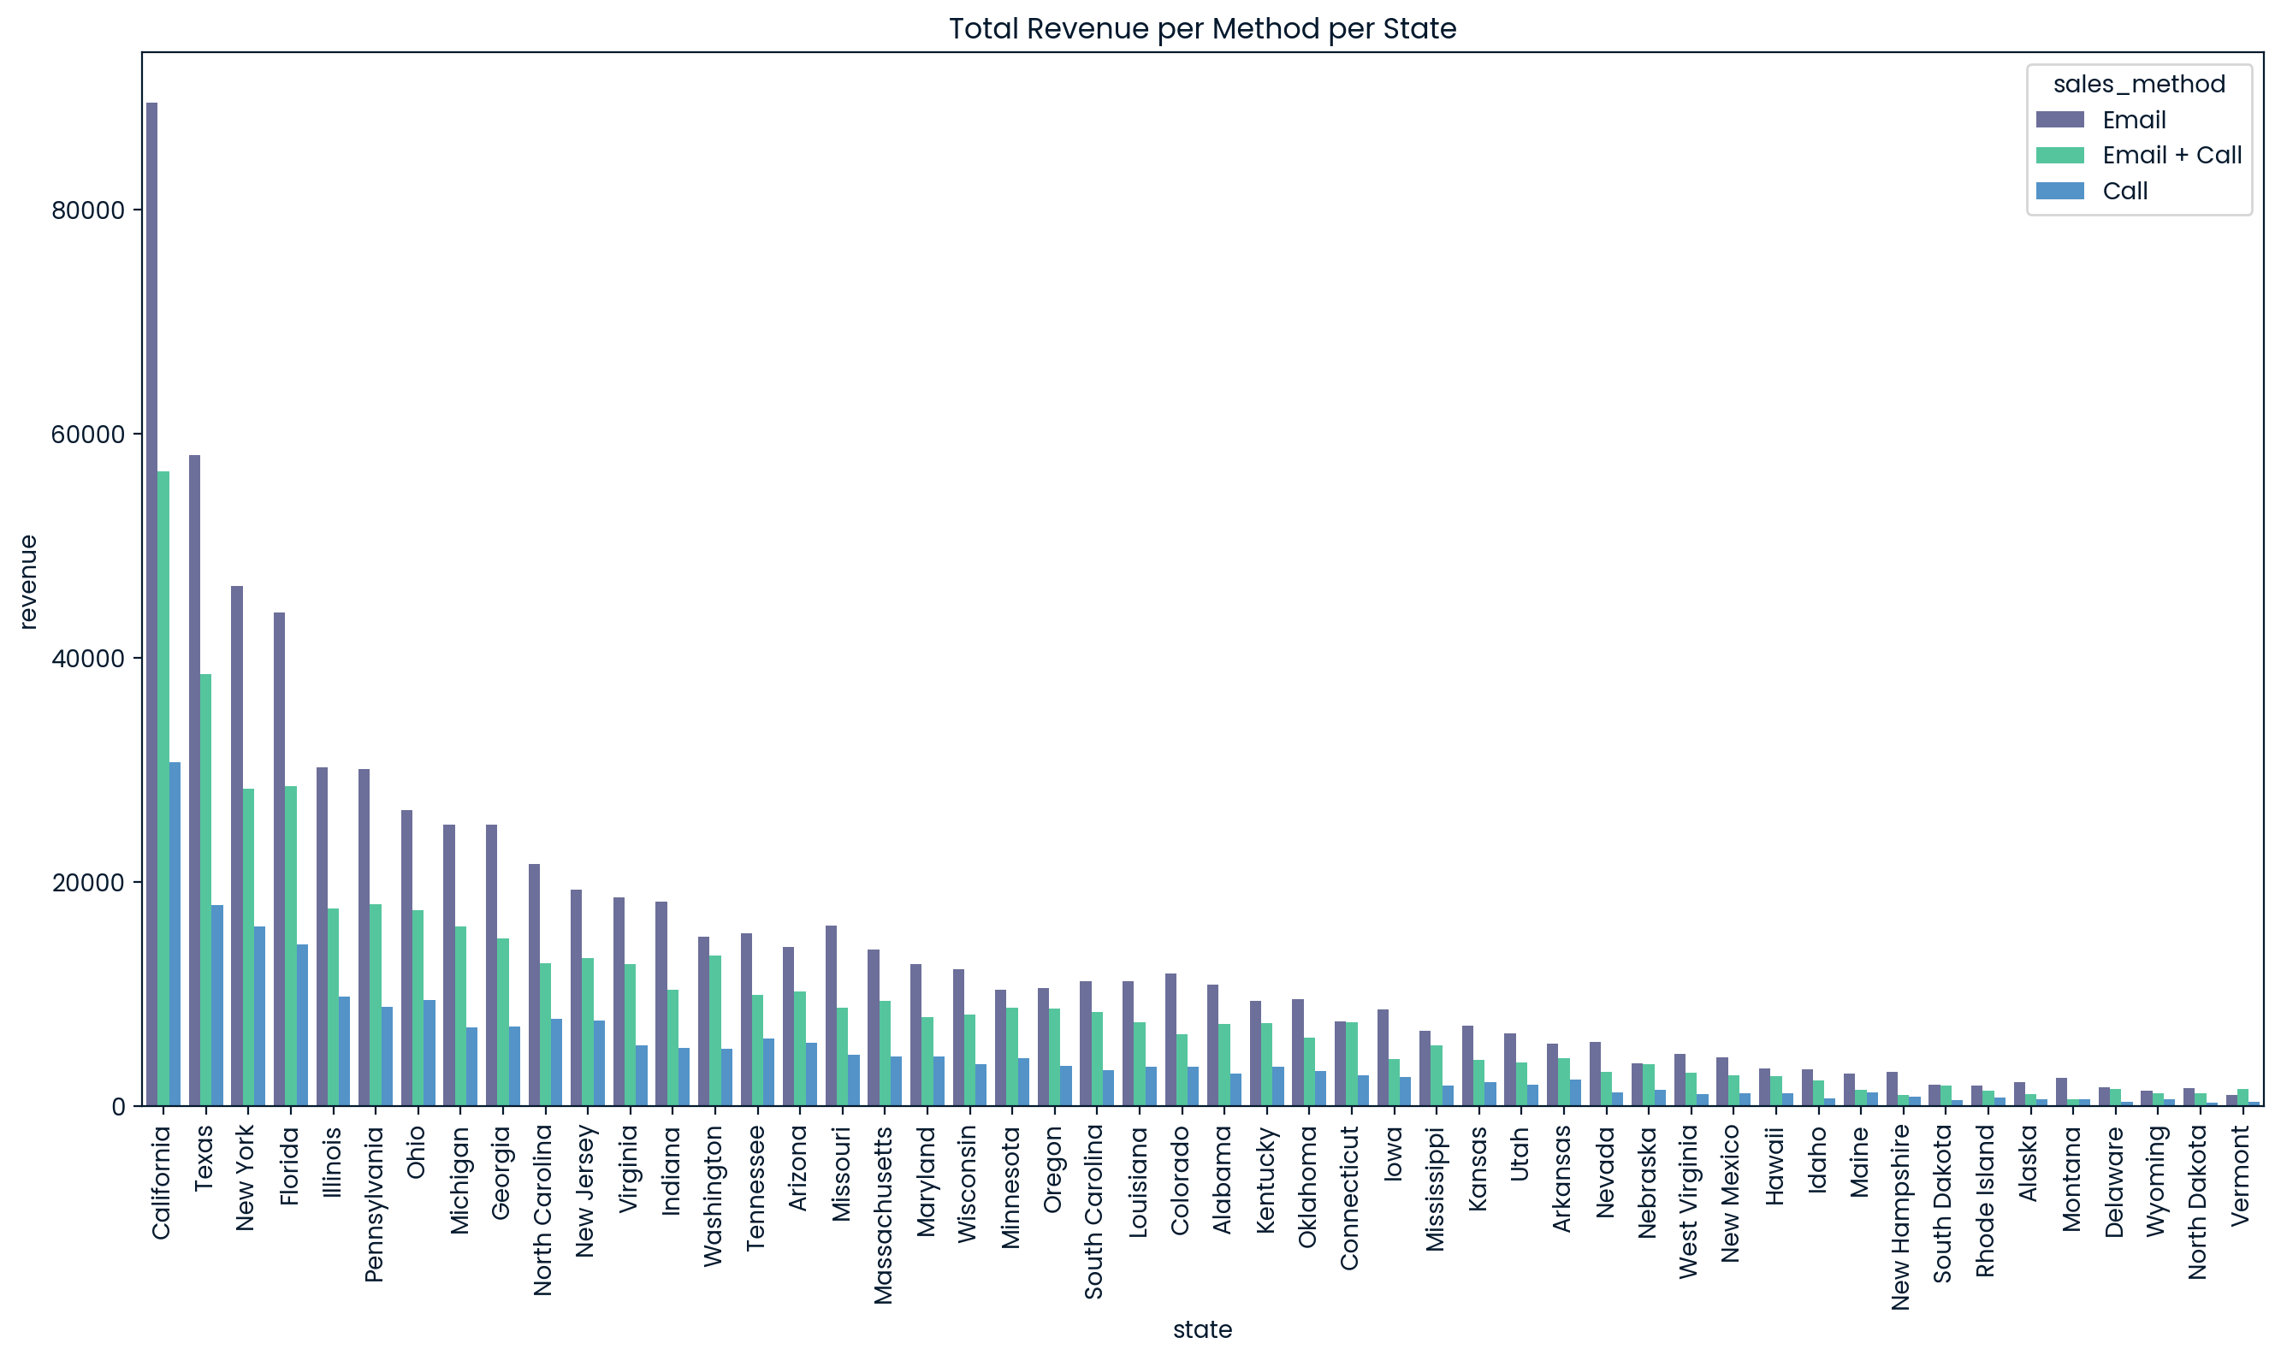
Key Findings Including the Metric to Monitor and Current Estimation
Some states need to be prioritized.
Notes:
California, Texas, New York, and Florida generate much higher sales regardless of the sales method used. These states should be prioritized during our sales efforts.

Slide 22

Key Findings Including the Metric to Monitor and Current Estimation
The key metric would be: Total Revenue per week on all three methods
If Total Revenue per week on Email + Call < Total Revenue per week on Email or Call, then switch to the highest revenue generating approach.
Notes:
The key metric for our business to monitor is total weekly revenue across all three methods. We need to track this regularly and choose the method that delivers the highest revenue. Based on our current estimations, the email plus call method is generating the highest revenue, so it’s the best approach to use for now. However, if revenue from this method drops below the revenue from the email or call methods, we’ll need to reconsider our approach.

Slide 23
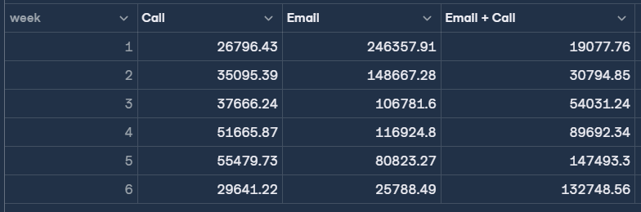
Key Findings Including the Metric to Monitor and Current Estimation
Current Estimations
Notes:
Here’s the current data, and you can see that the email plus call method resulted in much higher sales during the most recent week.

Slide 24
Recommendations to the Business
My Suggestion is we should go with the Email + Call method, since as time goes by, the sales would increase much more than the other methods do. It is definitely worth the extra 10 minutes time of our sales team to adopt this approach.
You should keep track of your average revenue. If average revenue of Email + Call method becomes less or equal to Email or Call method, then it would be more suitable to revise the approach and choose the highest revenue generating one.

